Slide 1

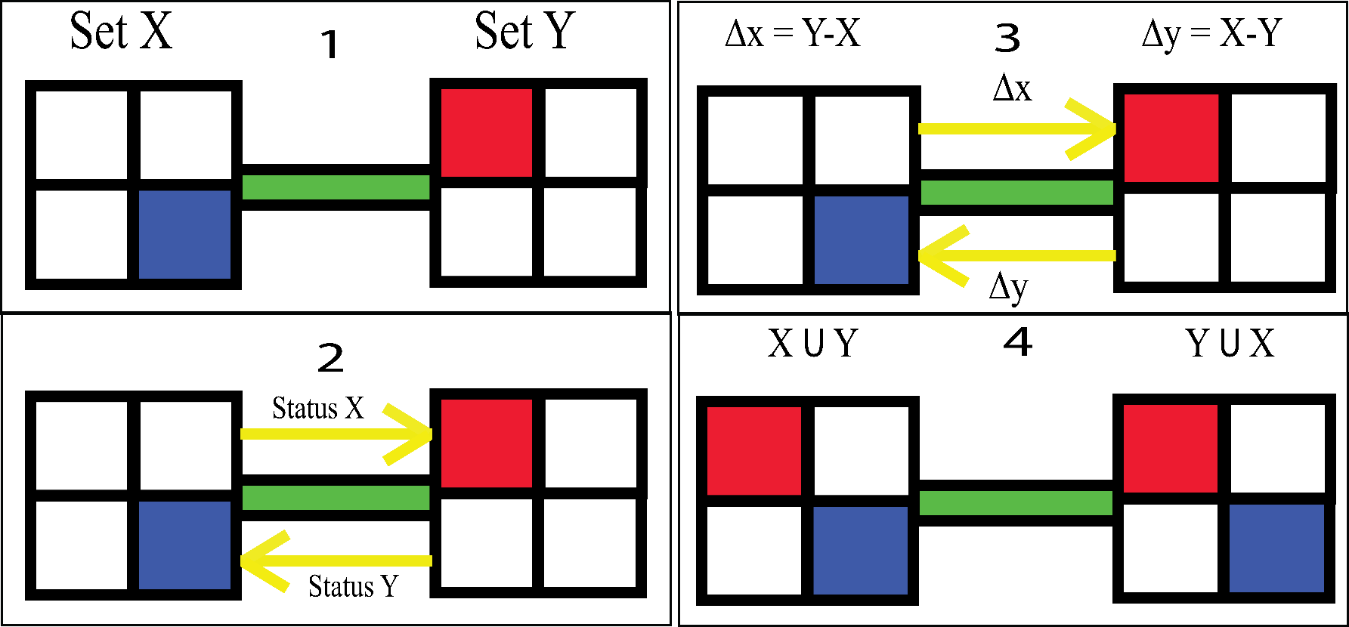
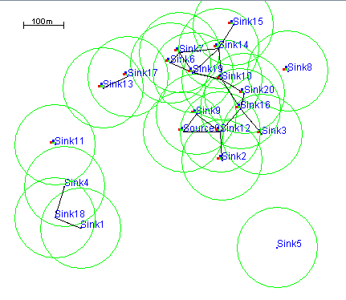
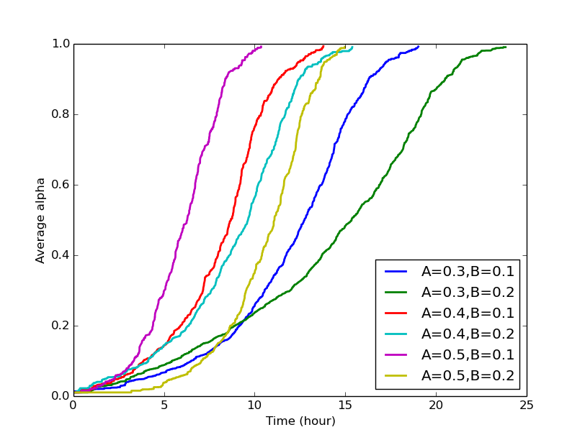
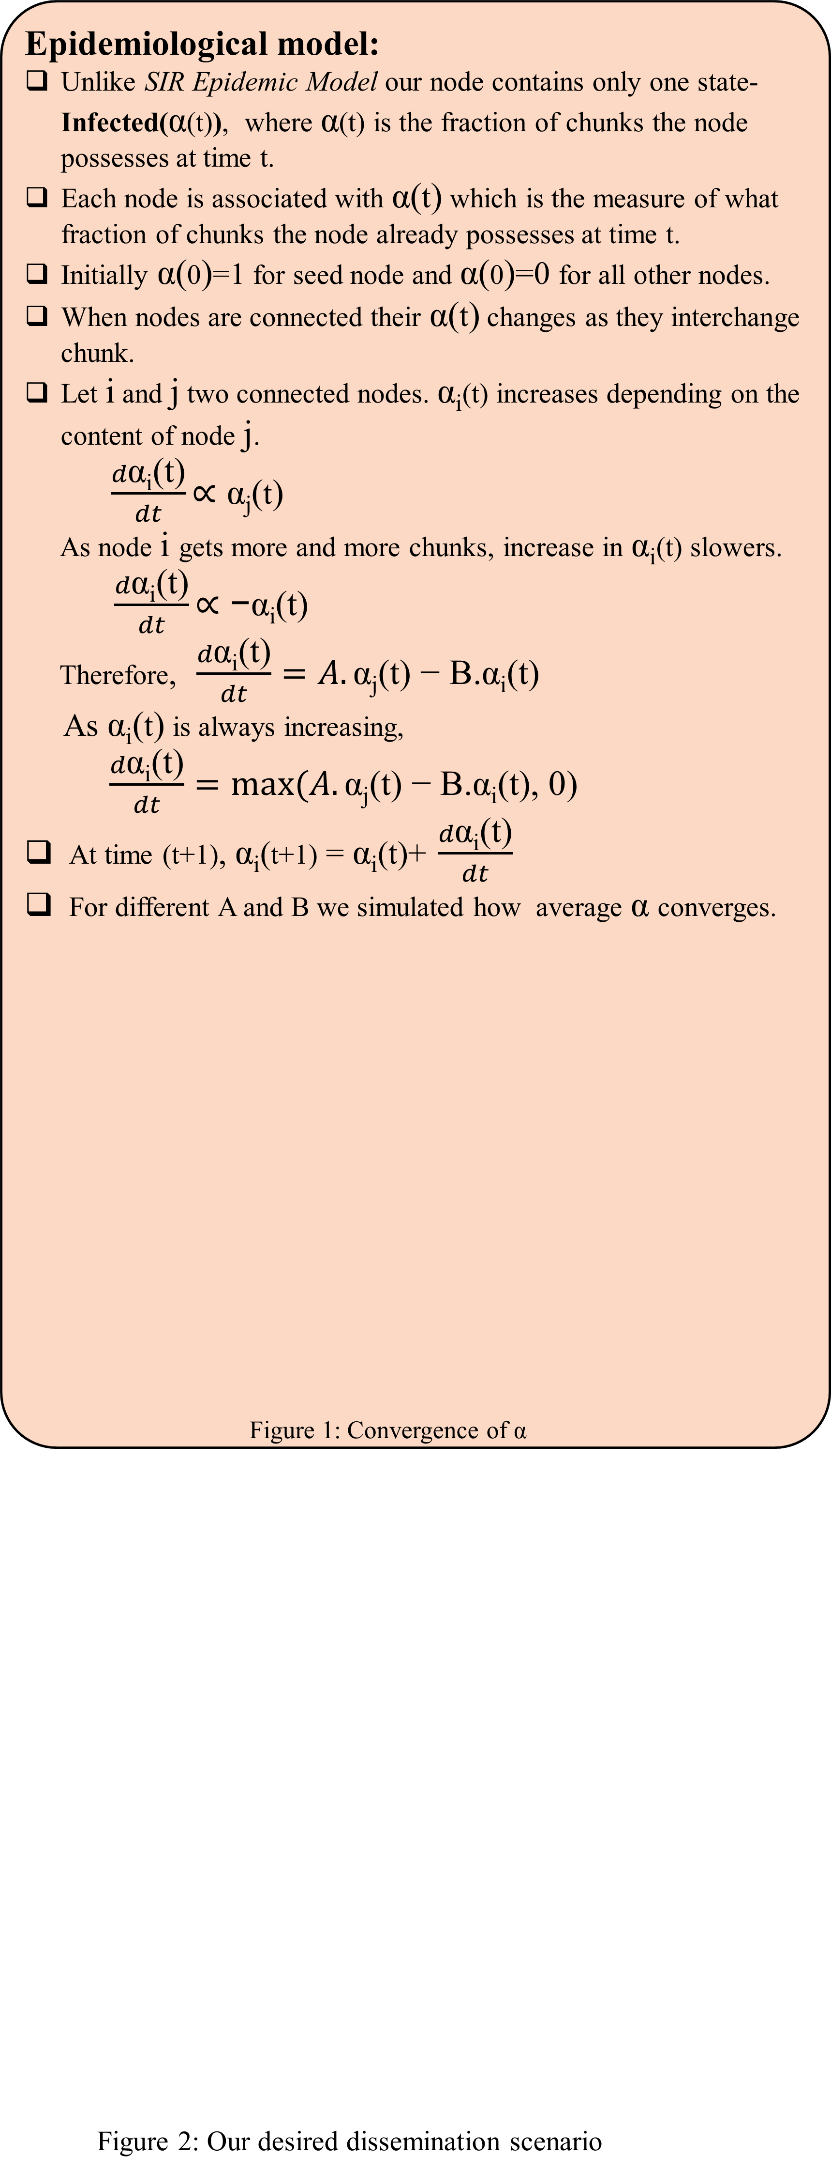
Viral Video Spread Over Human Space
Maruf Hasan Zaber, Mehrab Bin Morshed, Md Habibullah Bin Ismail
Problem Definition:
The ubiquitous nature of mobile phone has allowed it to be one of the major media of disseminating awareness information. Due to resource and compatibility constraint and low bandwidth availability, awareness information like Government Info are largely spread via text format. In this poster, we propose a novel approach of disseminating rich media content via peer to peer communication.
Dissemination Protocol
Dissemination protocol addresses which chunks to be disseminated to which node.
A set of initial nodes are selected who are given the full media content from a central source.
The file is divided into constituent chunks depending on the size of the content.
Figure 2: Interchange of chunks between two connected nodes
The chunks to be selected can be retrieved in three fashions –
i. Random.
ii. Least Disseminated Content First
iii. Round Robin Fashion
The node β, to be disseminated is selected at Random from set
Figure 3: A hypothetical dissemination scenario
Background:
Rich media content provides more effective way of learning than traditional text based content. Dissemination of rich media content to a targeted community via wireless technology is an interesting research direction. Our proposed dissemination technique is analogous to Susceptible, Infected & removed (SIR) Epidemic Model[1] which divides the file into constituent chunks and tends to spread them. Various disseminating techniques can be found in literature. Agarwal et al[2] showed that contents created and disseminated by users increased over time. John et al [3] adapted two new diffusion algorithms for many receivers to few senders and few receivers to many senders.
Epidemiological model:
Unlike SIR Epidemic Model our node contains only one state- Infected(α(t)), where α(t) is the fraction of chunks the node possesses at time t.
Each node is associated with α(t) which is the measure of what fraction of chunks the node already possesses at time t.
Initially α(0)=1 for seed node and α(0)=0 for all other nodes.
When nodes are connected their α(t) changes as they interchange chunk.
Let i and j two connected nodes. $\text{α}\text{i}$(t) increases depending on the content of node j.
$\frac{d\text{α}\text{i}\text{(}\text{t}\text{)}}{dt}\text{∝ }\text{α}\text{j}$(t)
As node i gets more and more chunks, increase in $\text{α}\text{i}$(t) slowers. $\frac{d\text{α}\text{i}\text{(}\text{t}\text{)}}{dt}\text{∝ }\text{−}\text{α}\text{i}$(t)
Therefore, $\frac{d\text{α}\text{i}\text{(}\text{t}\text{)}}{dt}=A.\text{α}\text{j}\text{(}\text{t}\text{) − }\text{B}\text{.}\text{α}\text{i}\text{(}\text{t}\text{)}$
As α_{i}(t) is always increasing,
$\frac{d\text{α}\text{i}\text{(}\text{t}\text{)}}{dt}=max⁡(A.\text{α}\text{j}\text{(}\text{t}\text{) − }\text{B}\text{.}\text{α}\text{i}\text{(}\text{t}\text{), 0)}$
At time (t+1), α_{i}(t+1) = α_{i}(t)+ $\frac{d\text{α}\text{i}\text{(}\text{t}\text{)}}{dt}$
For different A and B we simulated how average α converges.
Figure 1: Convergence of α
Figure 2: Our desired dissemination scenario
Result Analysis:
Our proposed dissemination protocol was simulated in Opportunistic Network Environment (ONE) simulator. Below we present the evaluation of one simulation instance in which random chunk selection was used. The parameters are as following –
Simulation Time- 2300s, Node Number- 21, Chunk Size- 1MB, Movement- Random Walk
Figure 3.1: Topology Figure 3.2: Graph
Simulation was conducted with different data transmission rate.
Conclusion and Future Work:
In this poster, we attempted to analyze a novel way of disseminating rich media files containing awareness information to a large population. We focused to the dissemination model and protocol. The three strategies we propose here need more robust investigation to prove their fruitfulness. Also the selection of initial seed peer is still largely unaddressed. In our future work, we look forward to focus in these issues.
References:
[1] Kermack, W. O. McKendrick, A. G. (1927). "A Contribution to the Mathematical Theory of Epidemics". Proceedings of the Royal Society A: Mathematical, Physical and Engineering Sciences115 (772): 700
[2]Agarwal, S.K., Kumar, A., Nanavati, A.A., and Rajput, N., Content Creation and Dissemination by-and-for Users in Rural Areas. ICTD, Doha, Qatar, Apr 2009.
[3] John Heidemann, Fabio Silva, and Deborah Estrin. 2003. Matching Data Dissemination Algorithms to Application Requirements. SenSys '03.
Department of Computer Science and Engineering (CSE), BUET

